Slide 1



Shaping Future India
AccidentDB

Slide 2
Objectives
1.Quantifying Accident Severity:
Determining the total number of cases,
injuries, and deaths from different types of
traffic accidents across the regions.
2. Comparative Analysis:
Identifying and comparing the most and least affected regions (States, UTs, and Cities)
3.Identifying Accident Type Dominance:
Determining which type of accident (road, railway, or railway crossing) is the primary contributor.
4.Risk Assessment (e.g., Fatality Rate):
Calculating and comparing key metrics like the Fatality Rate (Died / Cases) or Injury Rate (Injured / Cases) for different regions

Slide 3
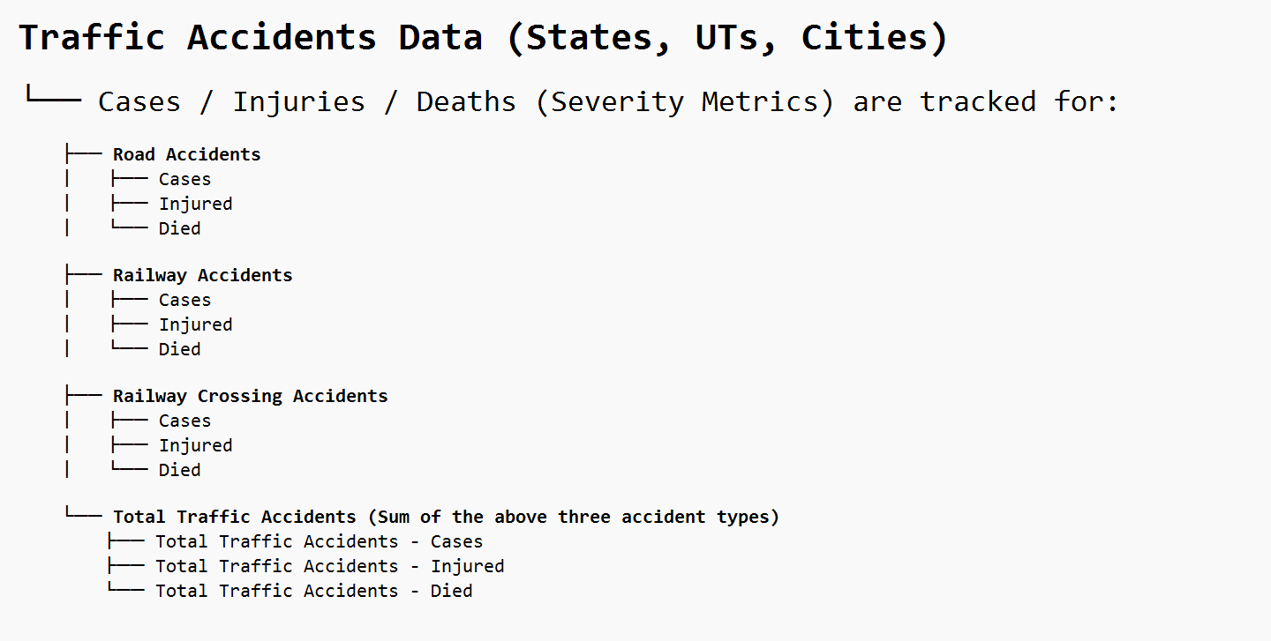
DATASET

Slide 4
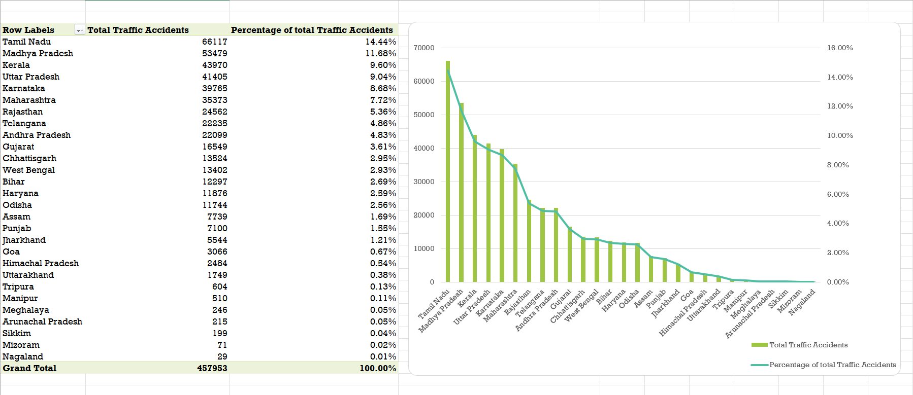
Extra Insights
Insights:
The Top 5 states — Tamil Nadu, Madhya Pradesh, Kerala, Uttar Pradesh, and Karnataka — together account for over 53% of all traffic accidents in India, showing that accidents are highly concentrated in a few regions. Tamil Nadu alone contributes 14.4%, meaning 1 in every 7 accidents in the country occurs there. The Top 10 states make up nearly 80% of total accidents, while northeastern states like Nagaland, Mizoram, and Sikkim report very few incidents, likely due to lower traffic density or better road safety. Since more than half of all accidents occur in the top 5 states, improvement efforts should be prioritized in these regions first.

Slide 5
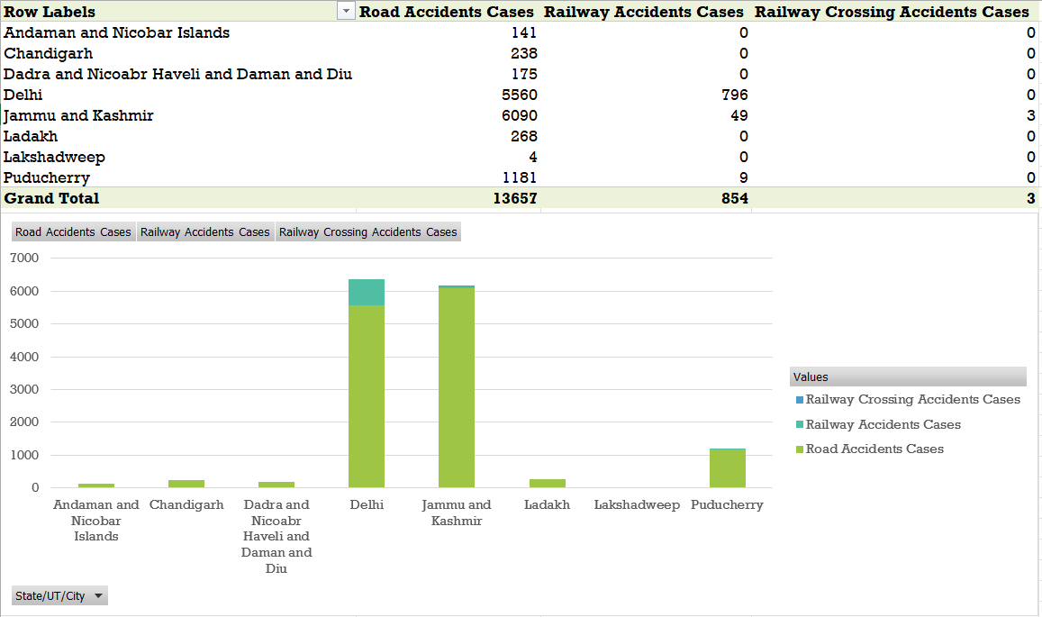
Data Insights Summary:
The data and graph show that road accidents are the dominant cause of total accidents across all union territories. Jammu and Kashmir records the highest number of road accidents, followed by Delhi, which also shows a notable count of railway accidents. In contrast, other regions report very few incidents, and railway and railway crossing accidents are almost negligible overall, highlighting that road safety remains the primary concern, especially in Jammu & Kashmir and Delhi.

Slide 6
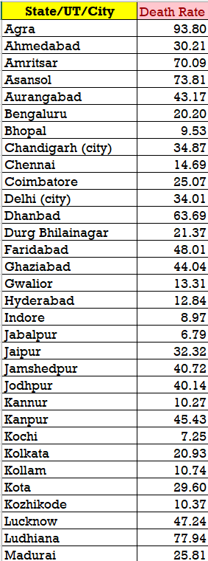
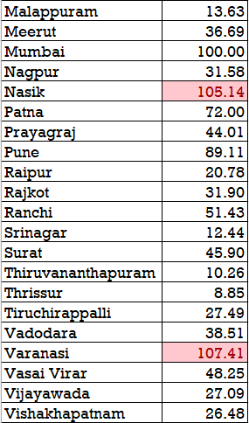
Data Insights Summary:
Most cities show reasonable death rates, but Nasik and Varanasi exceed 100%, which is clearly unusual. Instead of deleting them, we will flag these anomalies for review to keep the data complete. Cities like Mumbai, Agra, and Pune have very high death rates, indicating severe accidents, while cities like Jabalpur, Kochi, and Thrissur show very low rates, reflecting safer roads or better emergency services. This helps us identify both real safety issues and data inconsistencies.

Slide 7
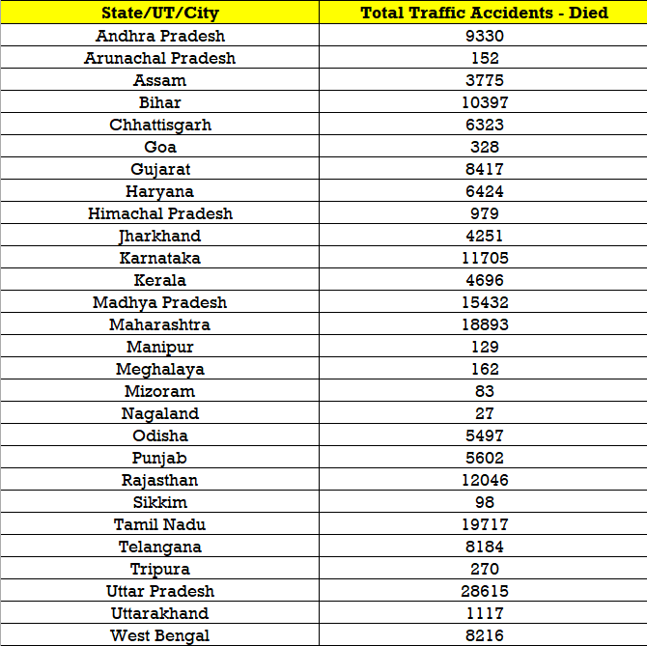
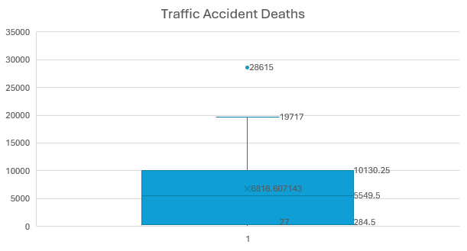
Data Summary Insights:
The box-and-whisker plot shows a wide range of traffic accident deaths across regions, from a minimum of 27 to a maximum of 19,717. The median of 5,549.5 indicates that half of the regions have fatalities below this value. Most regions fall between Q1 (285) and Q3 (10,130), showing high variability. The outlier at 28,615 signals either a major accident hotspot or a potential reporting anomaly, which should be flagged but not deleted because they may highlight critical hotspots. This identifies regions with extremely high fatalities that need immediate attention, while most areas experience relatively fewer deaths.

Slide 8
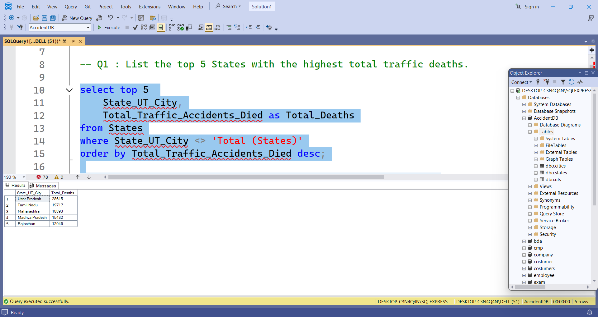
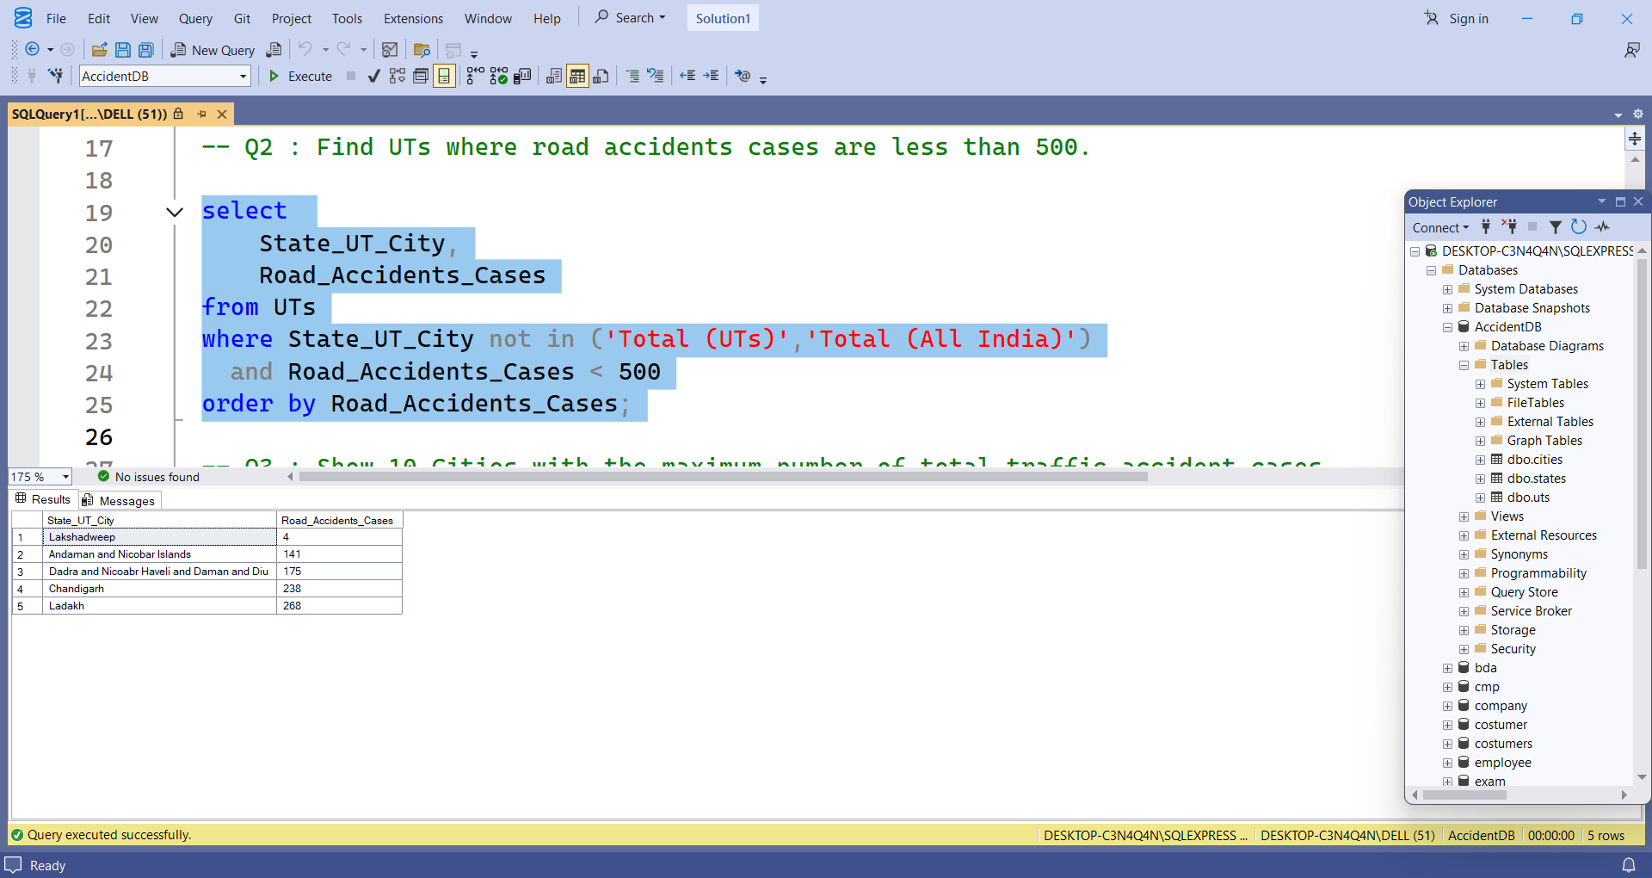
Insight:
Tamil Nadu records the highest traffic deaths (16,875), followed by Madhya Pradesh and Uttar Pradesh. The top 5 states show that major, high-population regions face serious road safety challenges across India.
Insight:
Union Territories like Lakshadweep, Andaman & Nicobar Islands, Daman & Diu, and Ladakh have fewer than 500 road accident cases, showing low traffic density and safer or less populated road conditions.

Slide 9
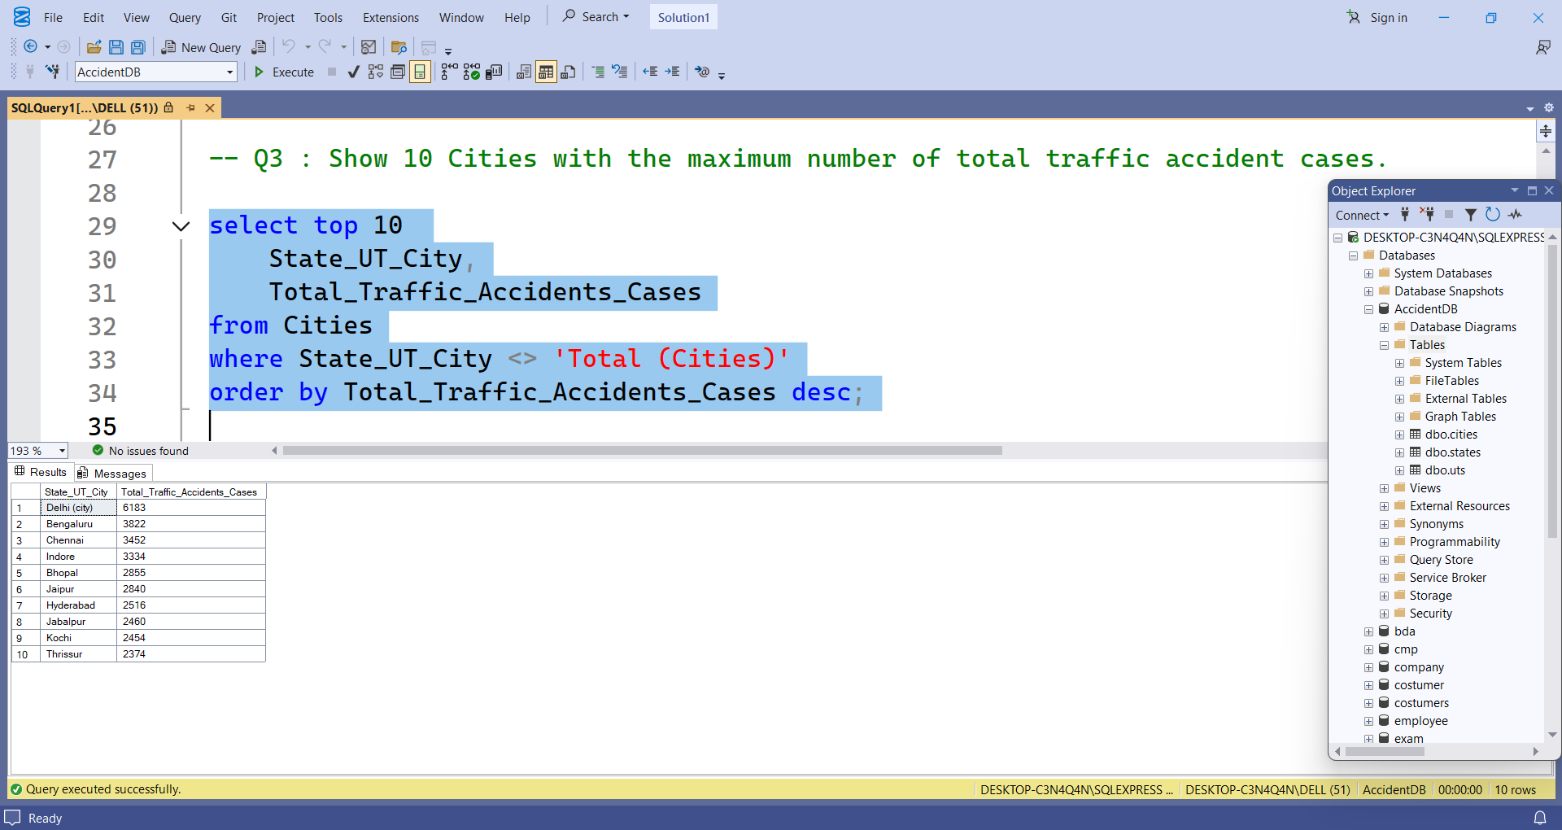
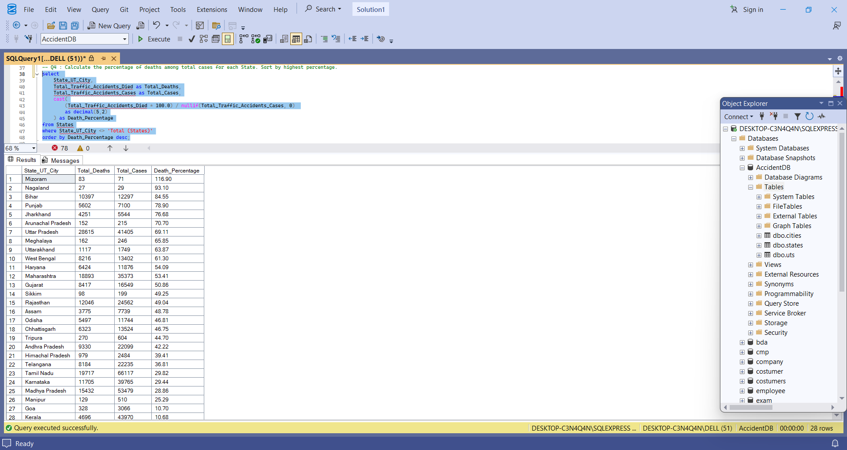
Insights :
Mizoram shows an unusually high death percentage (116.90%) – likely a data error.
Nagaland, Bihar, Punjab, Jharkhand have high fatality rates (70–90%) – indicating serious traffic safety issues.
Kerala and Goa have the lowest death percentages (~10%) – suggesting better accident response or safer roads.
Significant variation in death rates across states – possible differences in reporting or road safety infrastructure.
Insight:
Chennai reports the highest traffic accidents, followed by Indore and Bengaluru. Major metro cities face the most road accidents due to dense traffic and rapid urbanization.

Slide 10
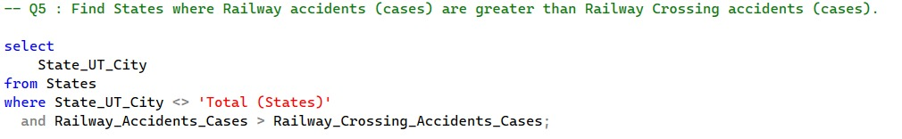
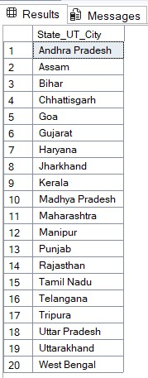
Insight:
In the 20 states listed, the number of general railway accidents (such as derailments, collisions, etc., along the tracks) is higher than the number of accidents that occur specifically at railway crossings.
Solution:
For these specific states, railway safety authorities might need to focus more on factors like track maintenance, signal integrity, and preventing trespassing on tracks, as opposed to solely focusing on improving safety at level crossings.

Slide 11
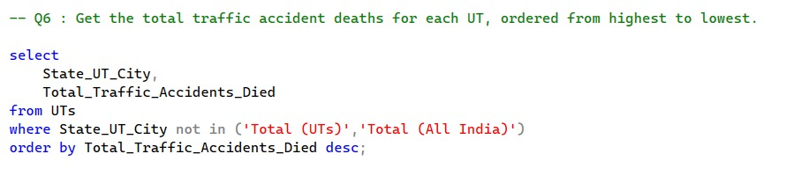
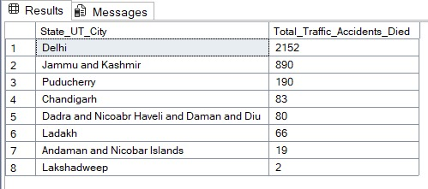
Insight:
To find the total number of deaths due to traffic accidents for each Union Territory (UT) in India, ordered from highest to lowest.
Solution:
The analysis shows a strong urban correlation — regions with more vehicles and complex traffic (Delhi, J&K) suffer far more fatalities, while isolated or smaller UTs have minimal deaths.

Slide 12
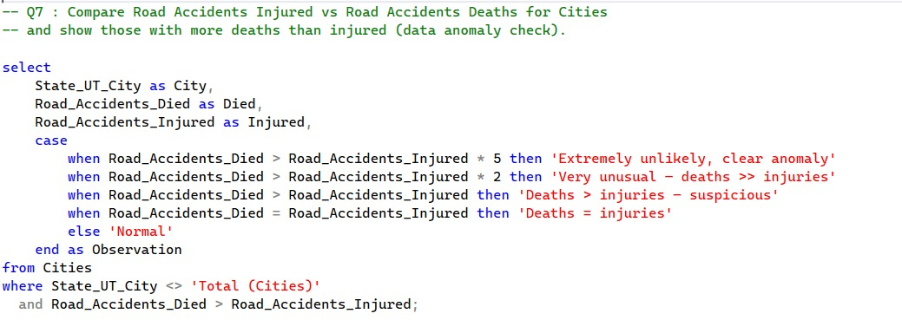
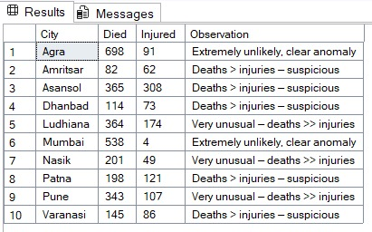
Insight:
The goal is to compare the number of people injured vs. the number of people who died in road accidents for various cities, and to identify anomalies — cases where deaths exceed injuries (which is highly unlikely in real data).
Solutions:
It reveals unrealistic accident statistics where deaths exceed injuries, flagging them for investigation. Such checks are crucial before using the data for analysis or reporting, as they prevent misleading conclusions in accident analysis and policy-making.

Slide 13
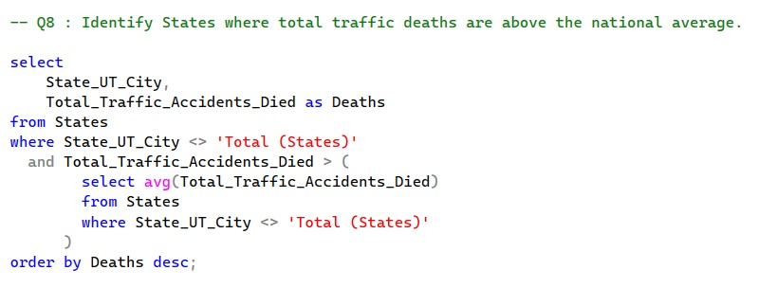
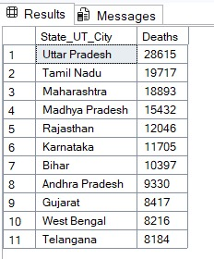
Insight:
To identify all States where the total number of traffic accident deaths is above the national average (for all Indian states combined).
Solution:
Identifies states with above-average road accident deaths, highlighting regions that require urgent policy focus and safety reforms. It provides a data-driven foundation for government agencies to allocate resources, improve enforcement, and ultimately reduce fatalities across the country.

Slide 14
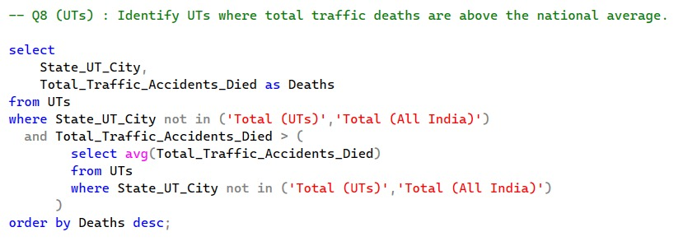
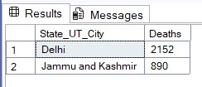
Insight:
This query identifies Union Territories (UTs) in India where total traffic deaths exceed the national average.
Solution:
only Delhi and Jammu & Kashmir have traffic death figures above the national UT average, with Delhi showing a significantly higher number. This indicates that these UTs may require focused interventions in traffic safety, infrastructure, and law enforcement to address the higher fatality rates.

Slide 15
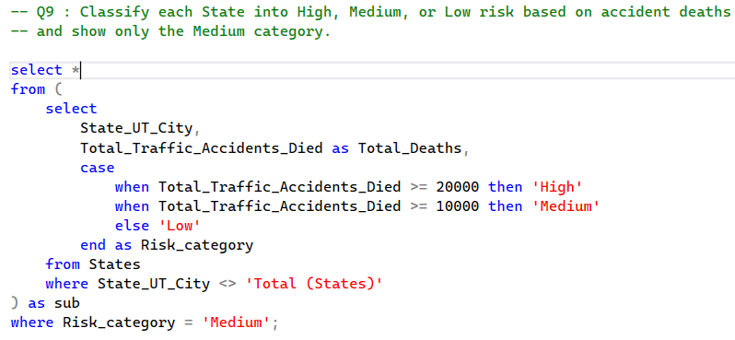
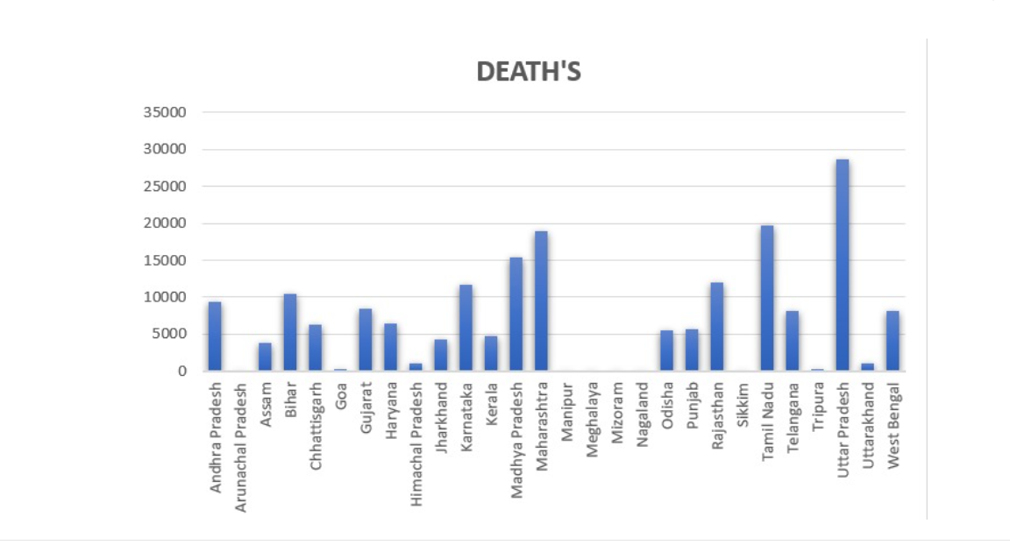
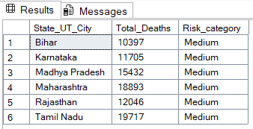

Slide 16
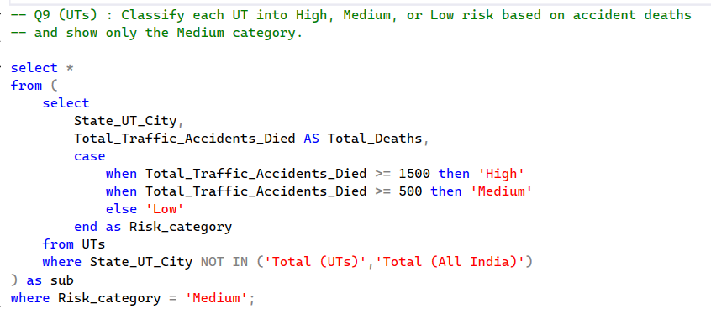
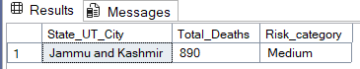
INSIGHT -- The query classifies UTs into High, Medium, and Low risk categories based on traffic accident deaths, showing only Medium-risk regions.
SOLUTION--
These areas have a moderate accident death rate and need focused road safety measures to prevent rising into the high-risk zone.

Slide 17
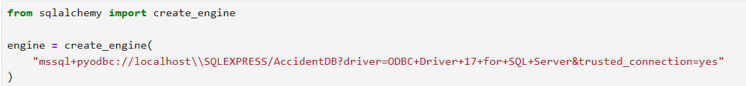
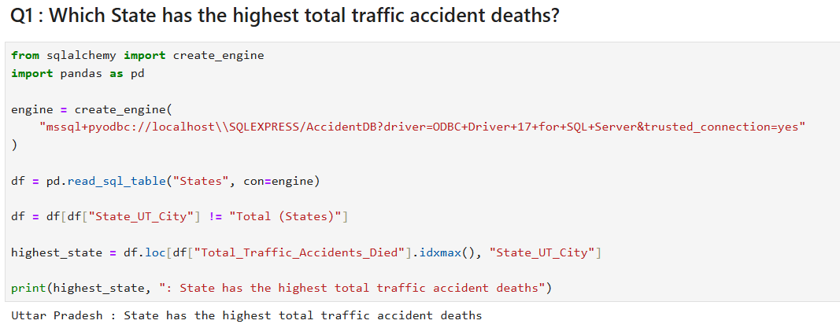
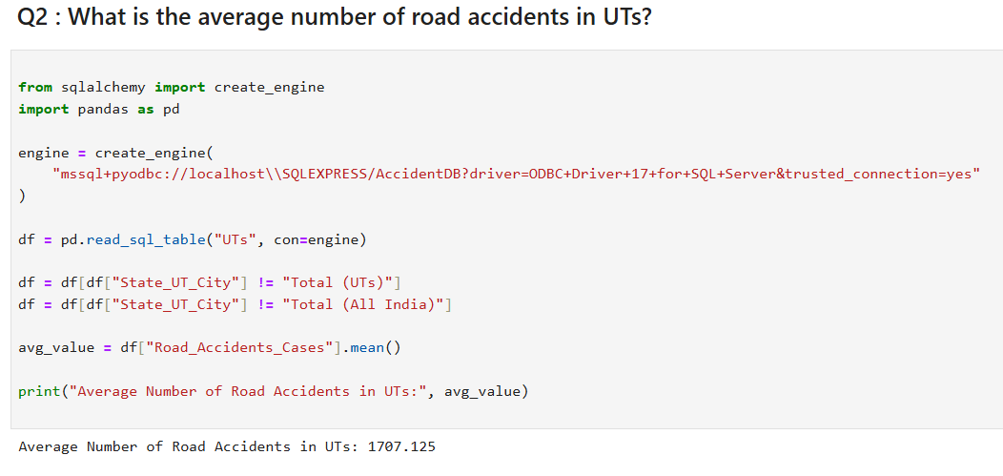
INSIGHT
Uttar Pradesh as the State with the highest total traffic accident deaths. This means Uttar Pradesh has the most severe road safety issue among all states, indicating high population, traffic density, and possibly weak enforcement of traffic rules or unsafe road conditions.
SOLUTIONS
Improve Road Infrastructure
Strict Traffic Law Enforcement Public Awareness Campaigns
INSIGHT
The average value = 1707.125, meaning that on average, each UT records about 1,707 road accident cases annually.
Conclusion:
Even though UTs are smaller, the accident rate is not negligible — emphasizing the need for stronger traffic regulation and public awareness campaigns across all UTs.

Slide 18
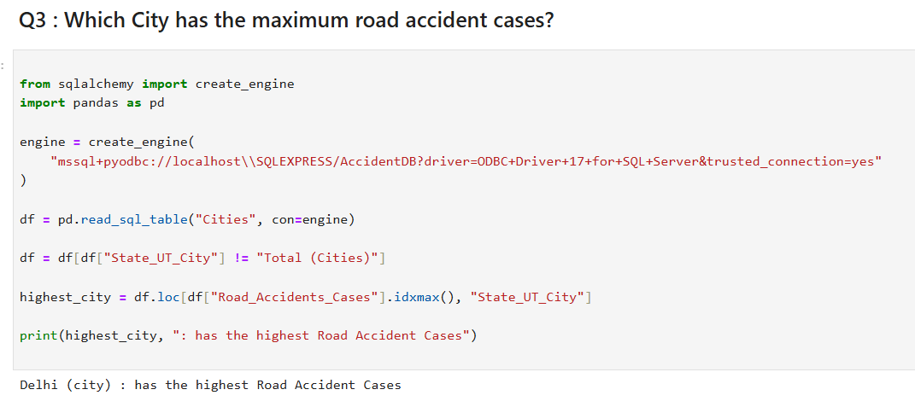
This indicates:
High population density and heavy traffic flow.
Possible lack of road safety enforcement or poor infrastructure planning.
SOLUTION
The need for immediate traffic control measures like stricter speed limits, improved road conditions, and public awareness campaigns.

Slide 19
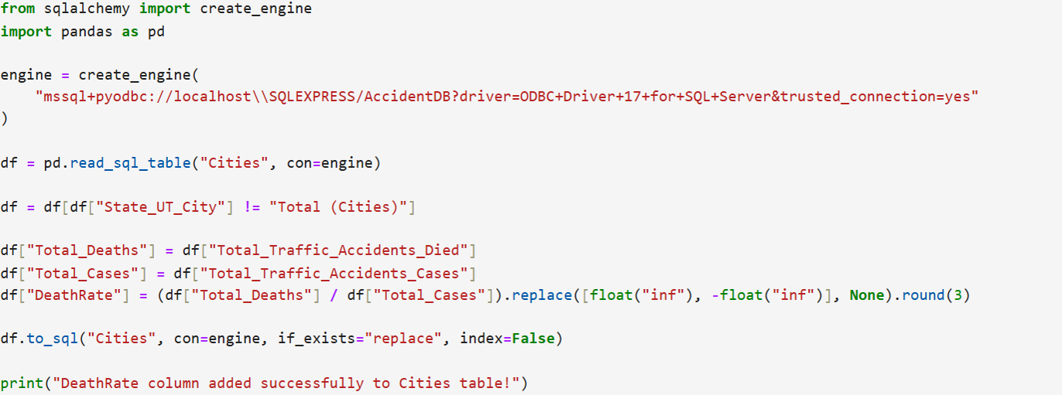
Add a new column in cities showing ‘DeathRate’ = Total Deaths / Total Cases
Code
Insights
This Python script connects to the AccidentDB database using pyodbc and alters the Cities table by adding a computed column named Death_Rate.
The column calculates the ratio of total deaths to total cases across different types of accidents (road, railway, railway crossing, and traffic).
The NULLIF function is used to prevent division by zero, and the result is stored as a decimal value with three decimal places.
Output -- Death_Rate column added successfully to Cities table

Slide 20
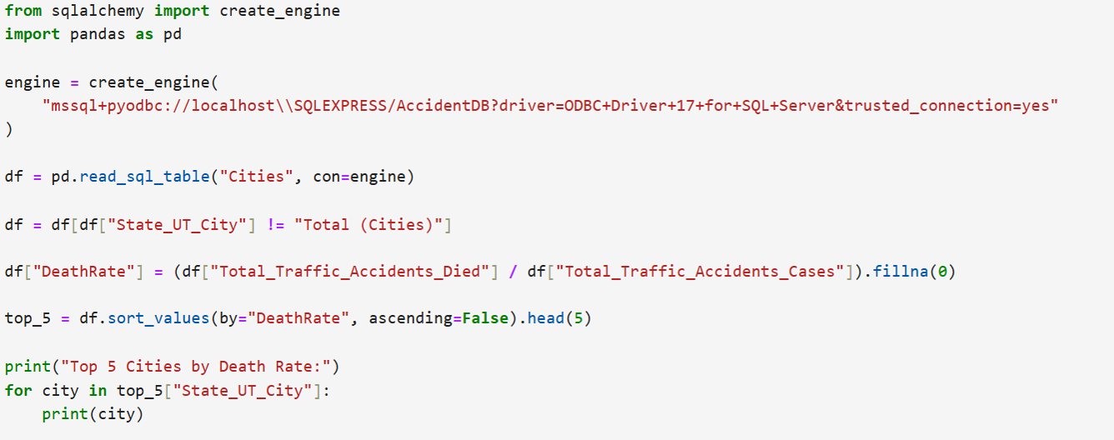
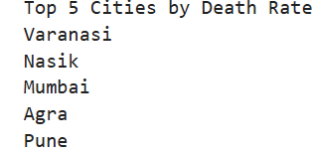
Q-5 Show Top 5 Cities by DeatRate

Slide 21
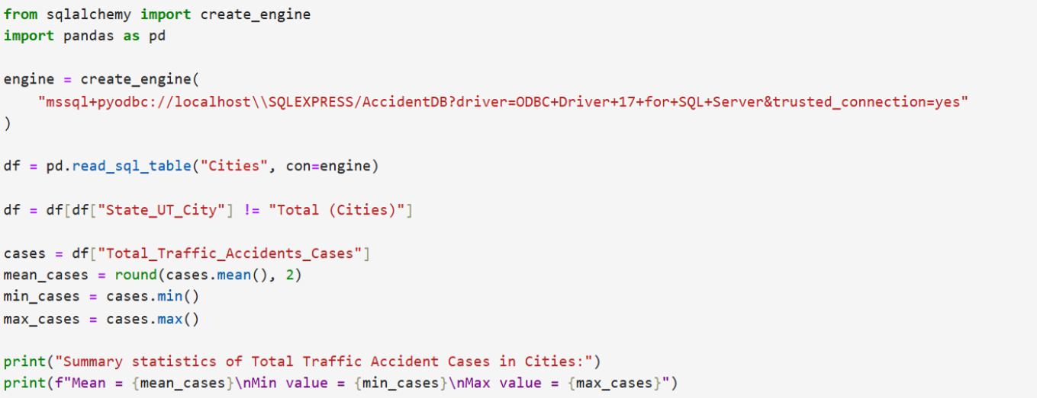
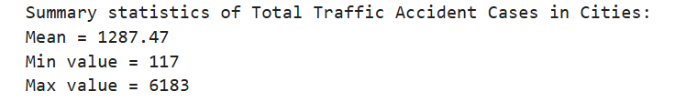
Q-6 Get summary statistics of total traffic accidents cases in Cities(mean,min,max)

Slide 22
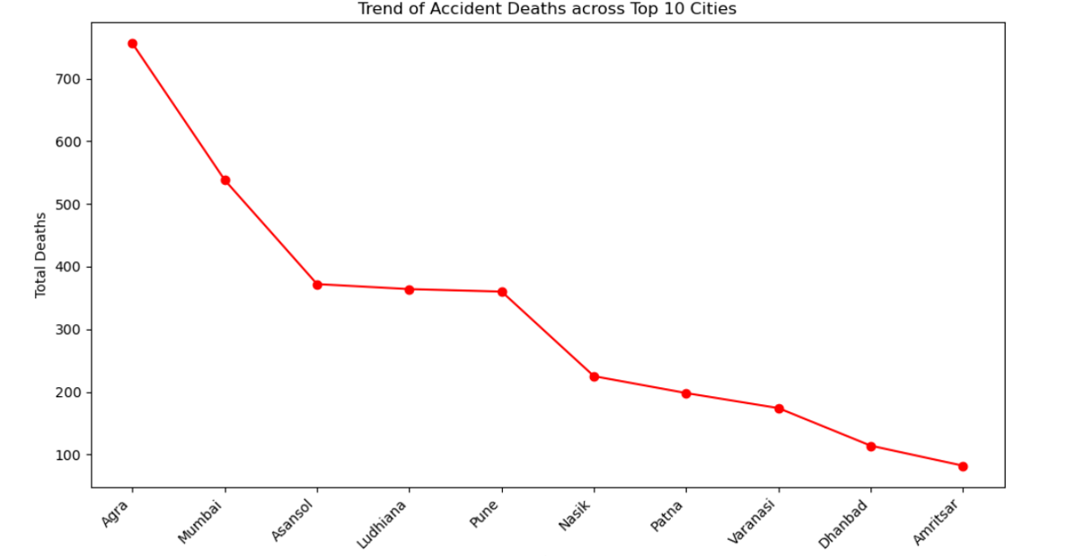
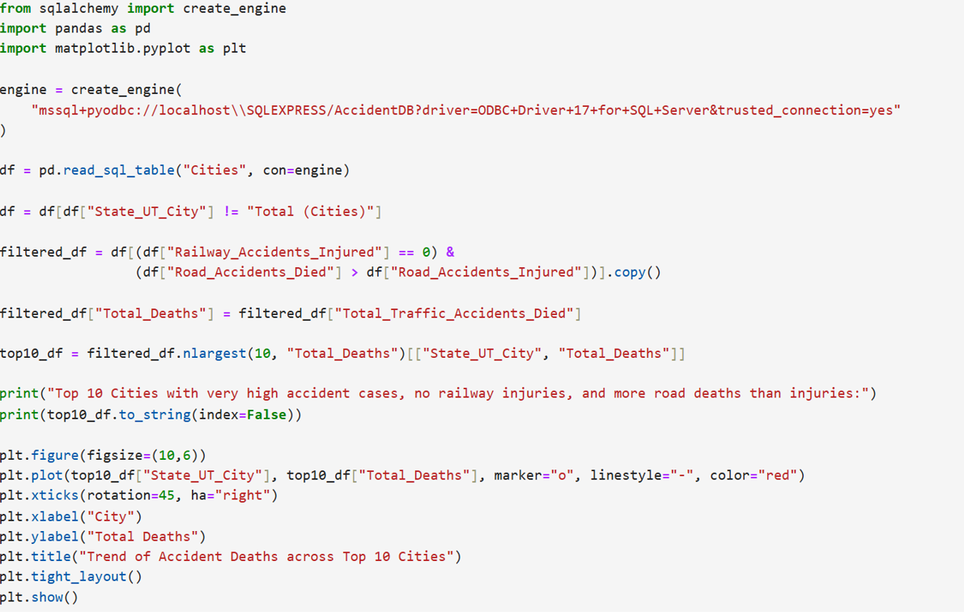
Top 10 Cities that have high Accident cases, No railway Injuries and More road Deaths than Road Injuries:
Code

Slide 23
Key Learnings
Regions with High Casualties:
States like Uttar Pradesh, Maharashtra, Tamil Nadu, Madhya Pradesh, Karnataka, and cities like Mumbai, Varanasi, Nasik, Pune, Agra, and Delhi, along with UTs like Delhi and Jammu & Kashmir, report the highest fatalities.
Data Anomalies & Outliers:
Some regions like Uttar Pradesh and cities like Nasik and Varanasi show unusually high deaths compared to others. These unusual cases are flagged for review but not removed, to keep the data complete and accurate.
Patterns in Accidents:
Most areas have moderate deaths, but a few regions face very high fatalities, showing uneven road safety and higher risk in busy cities.
Government Focus Areas:
High-risk areas need urgent action like better roads, traffic management, emergency services, and awareness campaigns, while moderate-risk regions need preventive measures.
Urban vs Rural:
Cities show big differences: some have very high deaths even with fewer accidents, meaning severe accidents are concentrated. Rural areas may have fewer accidents but higher deaths per accident, possibly due to poor emergency services or difficult roads.

Slide 24
Conclusion
In this project, we analyzed traffic accident data across States, Cities, and UTs using a combination of SQL, Python (Pandas), and Excel.
Our study explored trends, patterns, and variations in accidents, injuries, and fatalities across different regions. We also used graphs, charts, and visualizations to better understand the data, identify high-risk areas, and spot anomalies or outliers.
The analysis highlighted critical regions, emerging patterns, and areas with unusually high fatalities, providing valuable insights for road safety interventions, policy planning, and resource allocation.
Overall, this project demonstrates a comprehensive and data-driven approach to understanding traffic accidents and identifying regions that require urgent attention.

Slide 25

Thank You
Thank You

